Slide 1
Information Technology Fundamentals
DT228/1
Tutorial 3 - IT for Problem-Solving
Thursday 6 October 2016

Slide 2
Information Technology and Problem Solving
Problems: information requirements for business, other parts of society.
Solving them: using technology – computers, networks, ‘other things...’
What other things?

Slide 3

What Problems Again?
Technology changes rapidly.
Industry needs seem to be changing at a quicker rate than ever before.
Still need to gain and maintain a competitive advantage.
Education: teaching technology
in times of rapid tech change.

Slide 4
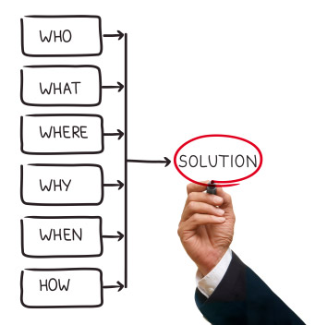
How do Technology People Spot Problems?
In industry:
Loss of finance
Loss of orders/reputation
Trade press
Word-of-mouth
OR
Business system investigation (Business-flavoured systems analysis)

Slide 5

Solving Problems
Industry might solve its ongoing problems by:
allowing for growth,
increasing revenue,
resolving the immediate issues, or
innovation...
...using Information Technology where possible.

Slide 6



Innovation
Buy the best (most appropriate) hardware, software, internet, training...
Education: going from teaching C++ to Java... To Python.

Slide 7

Innovation as Solution
How do you get innovation?
Through people who know the systems, and who can see a way of improving them (solving the problem).
Computer Science lecturer: asks ‘industry friends’ what language they want to see from graduates. Python? Design it into the curriculum.
Somebody has to think of these things.

